Slide 1
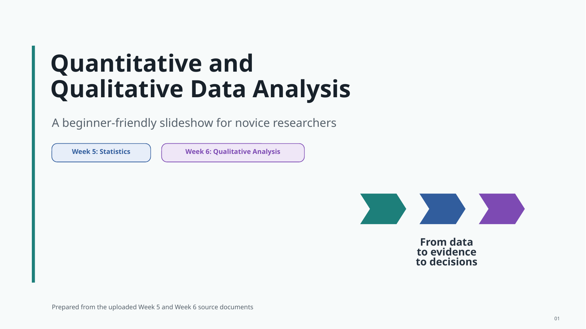
Quantitative and
Qualitative Data Analysis
Week 5: Statistics
Week 6: Qualitative Analysis
From data
to evidence
to decisions
Research Methodology 4
01

Slide 2
CRESWELL LENS
Creswell frames data analysis as connected work
Analysis is structured, layered and iterative: each phase informs the next, and earlier decisions may be revisited.
Structured
Layered
Iterative
Prepare and organise evidence using clear procedures, documented decisions and an explicit link to the research question.
Move from raw material to codes, categories, statistics, themes and interpretations at progressively higher levels.
Read, test, revise and represent findings in cycles rather than treating analysis as one final event.
Analysis is a reasoned movement from prepared data to transparent, proportionate claims (Creswell and Creswell, 2018).
01A

Slide 3

Qualitative analysis moves through an iterative spiral
Researchers move between preparation, coding, interpretation and representation rather than following a rigid line.
Qualitative analysis move
Output
Analytic aim
Why it is a spiral
Organise and prepare data
Dataset
Ready to analyse
Read broadly and memo
Memos
Overall sense
• Researchers revisit earlier material as understanding grows
• Coding, theme development and interpretation influence one another
• Visualisation can reveal gaps and prompt further analysis
Segment and code
Codes
Label meaning
Develop descriptions and themes
Themes
Explain patterns
Represent and visualise
Display
Show findings
Interpret with literature and context
Meaning
State significance
The sequence is organised, but the movement is recursive and reflective (Creswell and Poth, 2018).
01B

Slide 4
CRESWELL LENS
Quantitative analysis follows a staged evidence pathway
The logic moves from a clean dataset to description, inference and clear reporting.
Stage
Core actions
Researcher checks
1. Prepare the data
Score, clean and check missing values
Are variables coded correctly?
2. Describe distributions
Frequencies, centre and spread
What does the sample show?
3. Conduct inference
Tests, intervals and effect sizes
Do assumptions support the test?
4. Report the results
Tables, charts and objective text
Is the claim proportionate?
Quantitative analysis is sequential in logic, but checking and revision continue throughout (Creswell and Creswell, 2018).
01C

Slide 5
ANALYSIS BRIDGE
Both routes connect organised data to justified meaning
Qualitative and quantitative analysis differ in technique, but both depend on transparent reasoning.
Prepare evidence
Analyse patterns
Interpret and communicate
Organise, clean or transcribe the material; define units, variables and sources before analysis begins.
Use coding and themes for meaning-rich data, or descriptive and inferential statistics for numerical data.
Connect findings to the question, literature and context; represent them clearly and acknowledge limits.
Different paths, shared standard: every claim must remain traceable to evidence (Creswell and Creswell, 2018).
01D

Slide 6
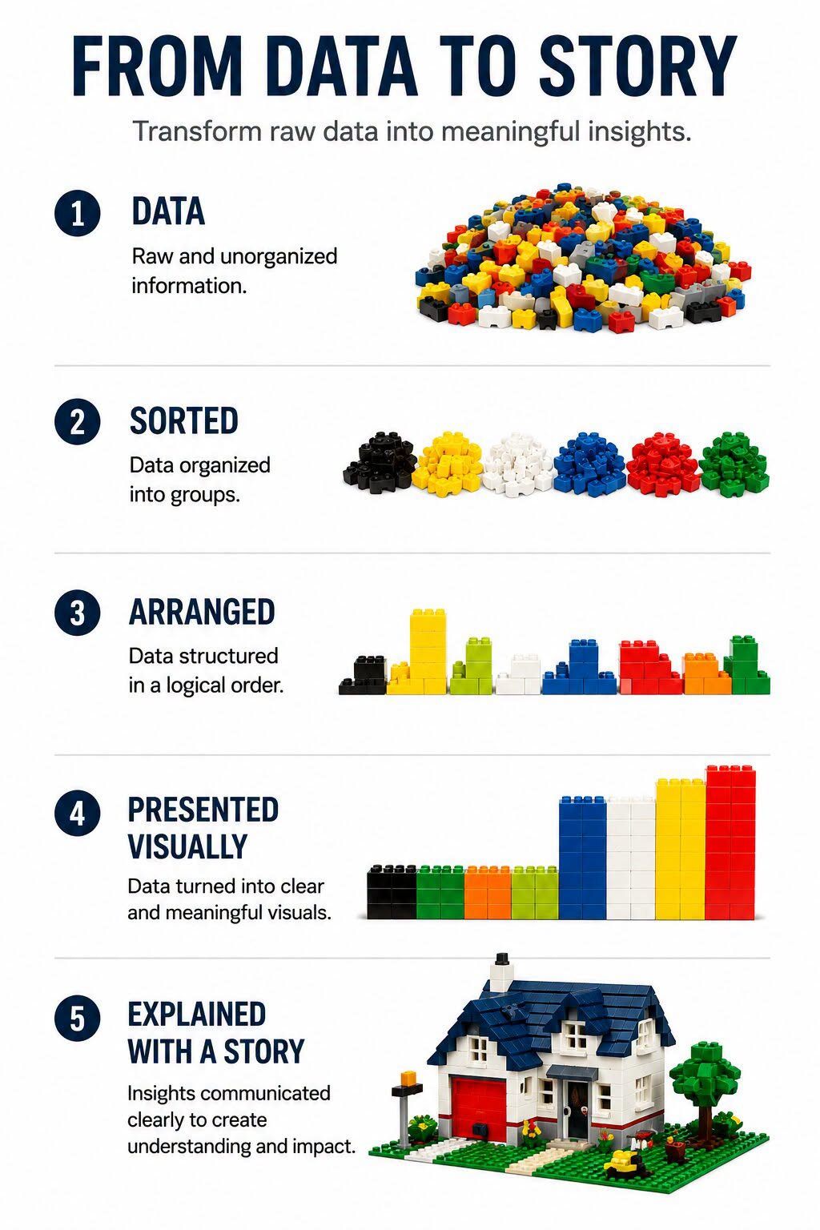
To transition your raw research data from simple, sorted categories into a compelling narrative, you must intentionally bridge the gap between what the data is and what it actually means.
Credit: https://gregmeyer.wordpress.com/2022/05/01/every-data-picture-tells-a-story/

Slide 7
Step 1:
Moving from "Sorted" to "Arranged" (Pattern Recognition)
Do not just list your categories. Look for structural relationships between them.
In Quantitative Research, this means moving beyond single variables (descriptive stats like means) and examining how variables interact (inferential stats like correlations or regressions).
In qualitative research, this means grouping isolated codes into overarching, broader themes.
Tip: Create a matrix or a mind map.
Ask yourself:
Which themes always appear together? Which variables conflict with each other?
Credit: https://gregmeyer.wordpress.com/2022/05/01/every-data-picture-tells-a-story/

Slide 8
Step 2:
Moving to "Presented Visually" (Data Display)
Before writing long paragraphs, create a clear visual anchor for your reader.
The Tool: Design a Joint Display (if mixed methods), a Conceptual Framework Diagram, or a clean Thematic Table.
Tip: Draft a table that lists your Main Theme, the Sub-themes underneath it, and 1–2 illustrative participant quotes or statistical data points for each. This gives your reader an instant snapshot of your architectural plan.
Credit: https://gregmeyer.wordpress.com/2022/05/01/every-data-picture-tells-a-story/

Slide 9
Step 3:
Moving to the "Story" (The Synthesis)
This is where you write the actual Data Analysis and then the Discussion section. A strong research story requires three elements:
The Evidence:
State clearly what the data shows (e.g., "75% of participants reported high burnout levels..." or "Theme 1 emerged as systemic exhaustion...").
The Context:
Explain why this is happening. This is your voice as a researcher, interpreting the human element or the statistical anomaly behind the numbers.
The Literature Connection:
Tie your house back to the neighbourhood. Connect your findings directly back to the literature.
Does your data agree, disagree, or add a completely new brick to existing theories?
Credit: https://gregmeyer.wordpress.com/2022/05/01/every-data-picture-tells-a-story/

Slide 10
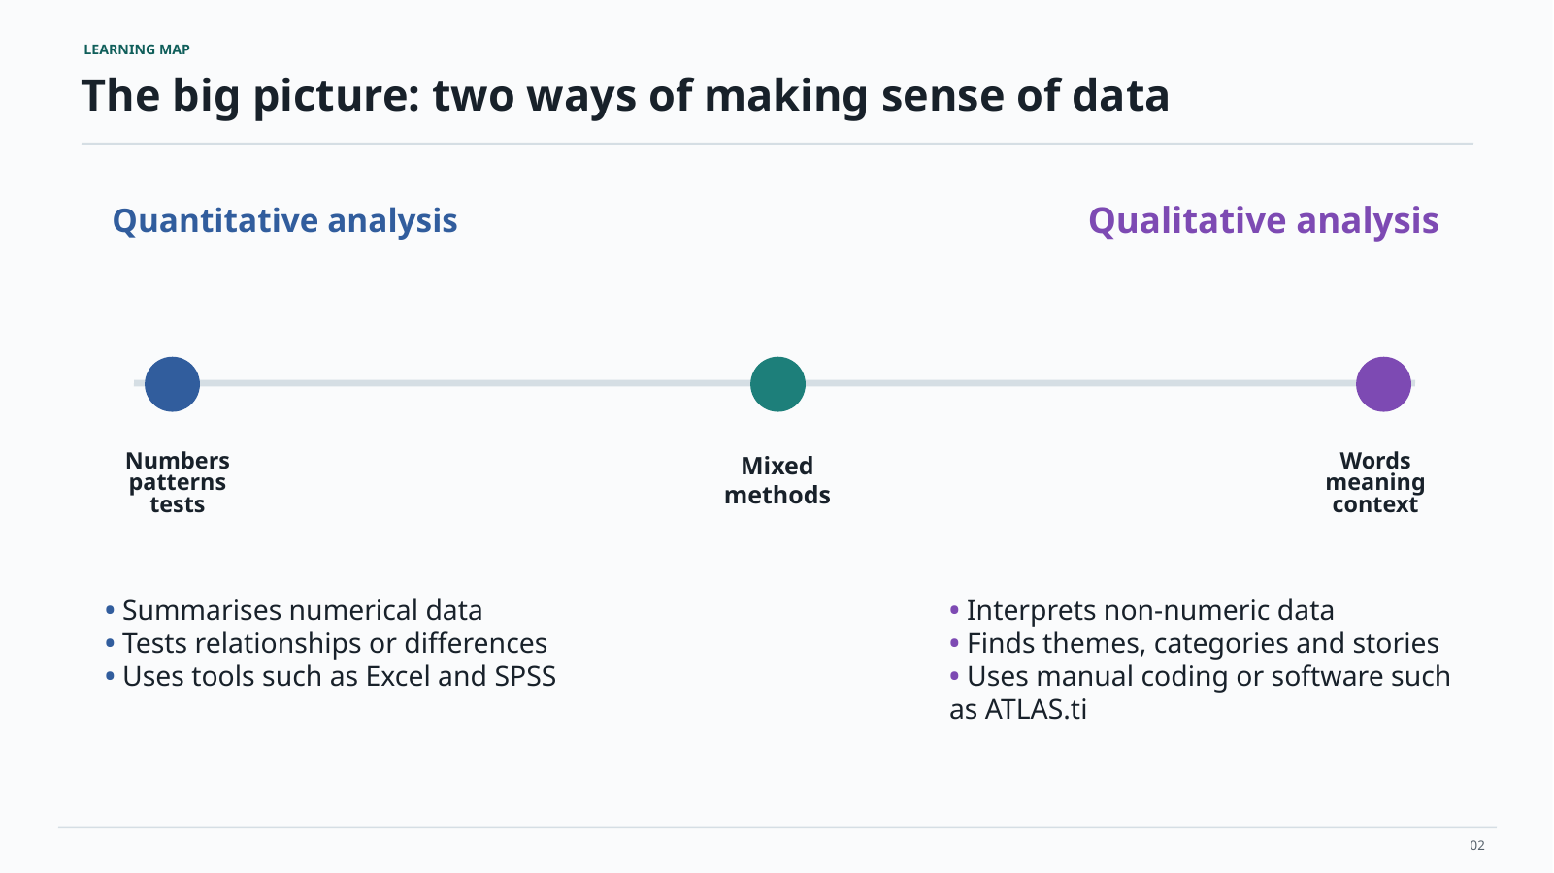
Two ways of making sense of research data
Quantitative analysis
Qualitative analysis
02

Slide 11
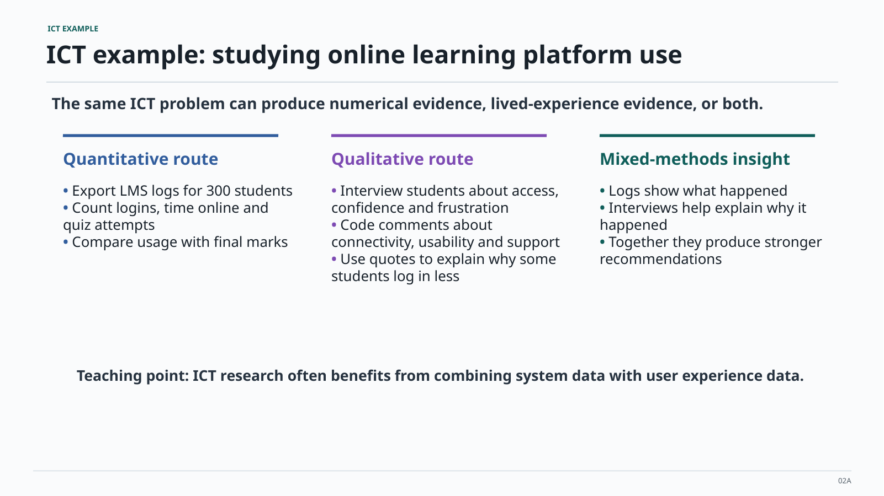
ICT example: studying online learning platform use
The same ICT problem can produce numerical evidence, lived-experience evidence, or both.
Quantitative route
Qualitative route
Mixed-methods insight
Export LMS logs for 300 students
Interview students about access,
Logs show what happened
Count logins, time online and
confidence and frustration
Interviews help explain why it
quiz attempts
Code comments about
happened
Compare usage with final marks
connectivity, usability and support
Together they produce stronger
Use quotes to explain why some
recommendations
students log in less
ICT research often benefits from combining system data with user experience data.
02A

Slide 12
In an SLR, the selected papers become your dataset
You are not collecting answers from people. You are extracting evidence from the studies you include.
Quantitative SLR data
Qualitative SLR data
Mixed SLR evidence
Numbers you extract or count from papers, for example publication year, method used, sample size, tool category, accuracy scores, adoption rates, or frequency of a theme.
Textual findings you extract from papers, for example authors’ explanations, participant quotations, discussion points, barriers, enablers, recommendations, and conceptual ideas.
Many ICT SLRs use both: count what the literature shows, then explain the patterns using themes from the studies.
Your SLR still generates data. The “raw data” is information taken systematically from the included studies.
04

Slide 13
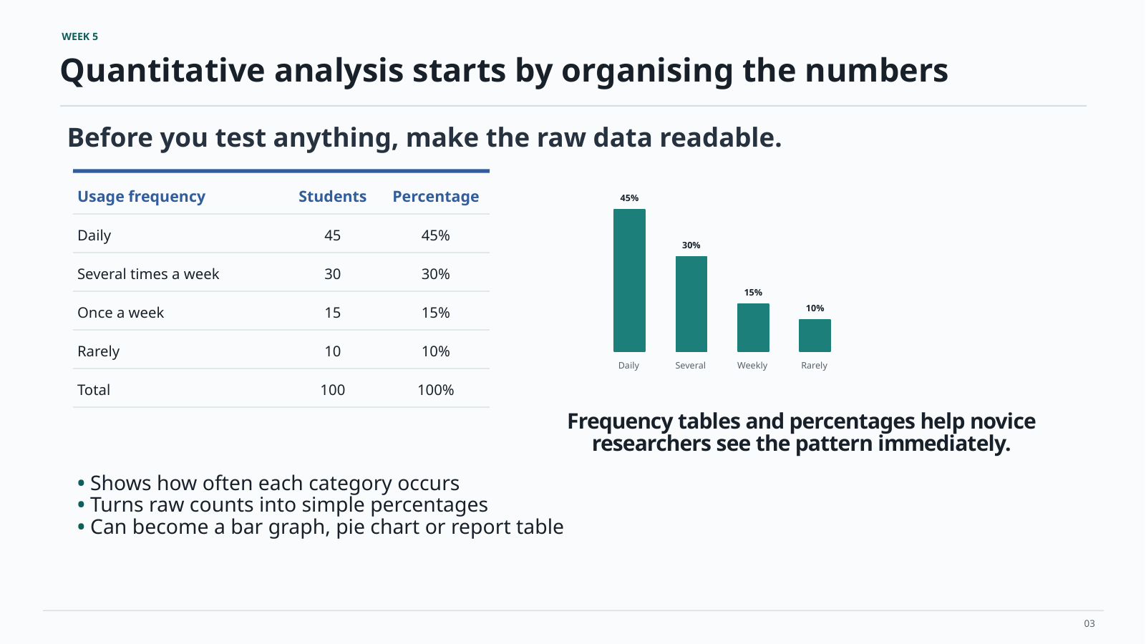
Quantitative analysis starts by organising the numbers
Before you test anything, make the raw data readable.
Usage frequency
Students
Percentage
45%
Daily
45
45%
Several times a week
30
30%
15%
Once a week
15
15%
10%
Rarely
10
10%
Daily
Several
Weekly
Rarely
Total
100
100%
Frequency tables and graphs help you
see the pattern immediately.
Shows how often each category occurs
Turns raw counts into simple percentages
Can become a bar graph, pie chart or report table
03

Slide 14
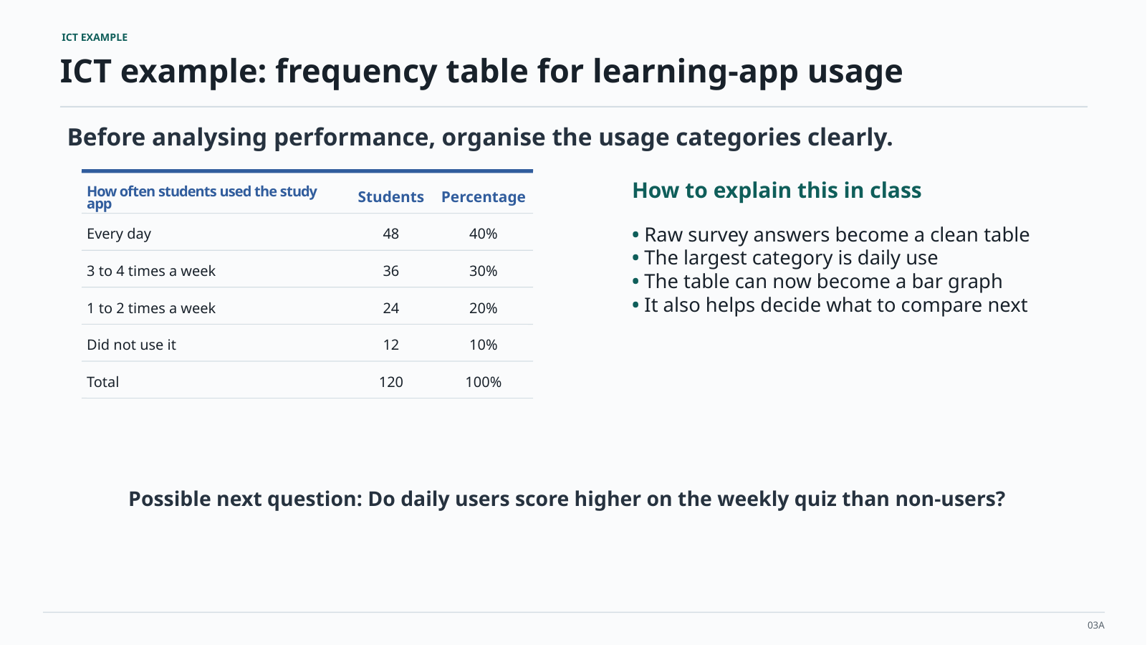
ICT EXAMPLE
ICT example: frequency table for learning-app usage
Before analysing performance, organise the usage categories clearly.
How often students used the study
Students
Percentage
How to explain this in class
app
Every day
48
40%
Raw survey answers become a clean table
The largest category is daily use
3 to 4 times a week
36
30%
The table can now become a bar graph
1 to 2 times a week
24
20%
It also helps decide what to compare next
Did not use it
12
10%
Total
120
100%
Possible next question: Do daily users score higher on the weekly quiz than non-users?
03A

Slide 15
SLR CONTEXT
SLR quantitative example: count what appears in the literature
Example SLR topic: What technologies are used to detect phishing attacks in higher education?
Technology category
Number of papers
Percentage
How this applies to the lecture
Machine learning classifiers
18
45%
• This is the same logic as a frequency table
• Each paper is one unit in your dataset
• The categories must be defined before counting
• Percentages help readers see the pattern quickly
Rule-based detection
8
20%
User-awareness training tools
7
17.5%
Browser/email plug-ins
5
12.5%
Other
2
5%
Total
40
100%
SLR output: “Most included studies used machine learning classifiers, while fewer focused on user-awareness tools.”
07

Slide 16
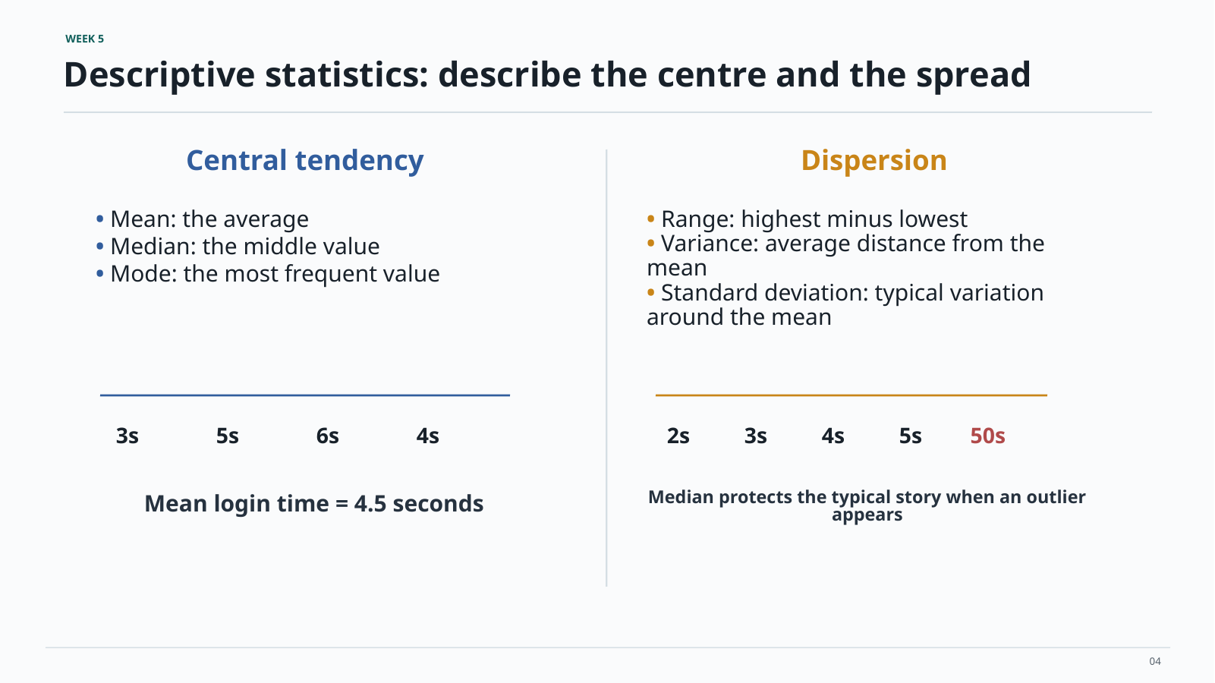
Descriptive statistics: describe the centre and the spread
Central tendency
Dispersion
3s
5s
6s
4s
2s
3s
4s
5s
50s
04

Slide 17
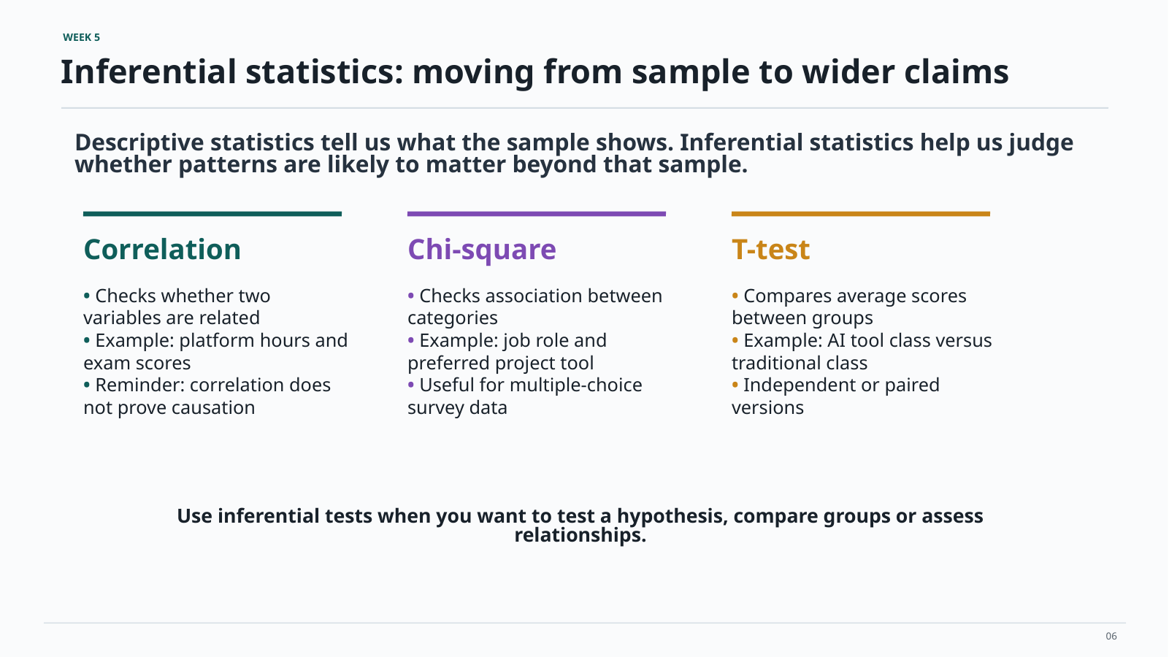
Inferential statistics: moving from sample to wider claims
06

Slide 18
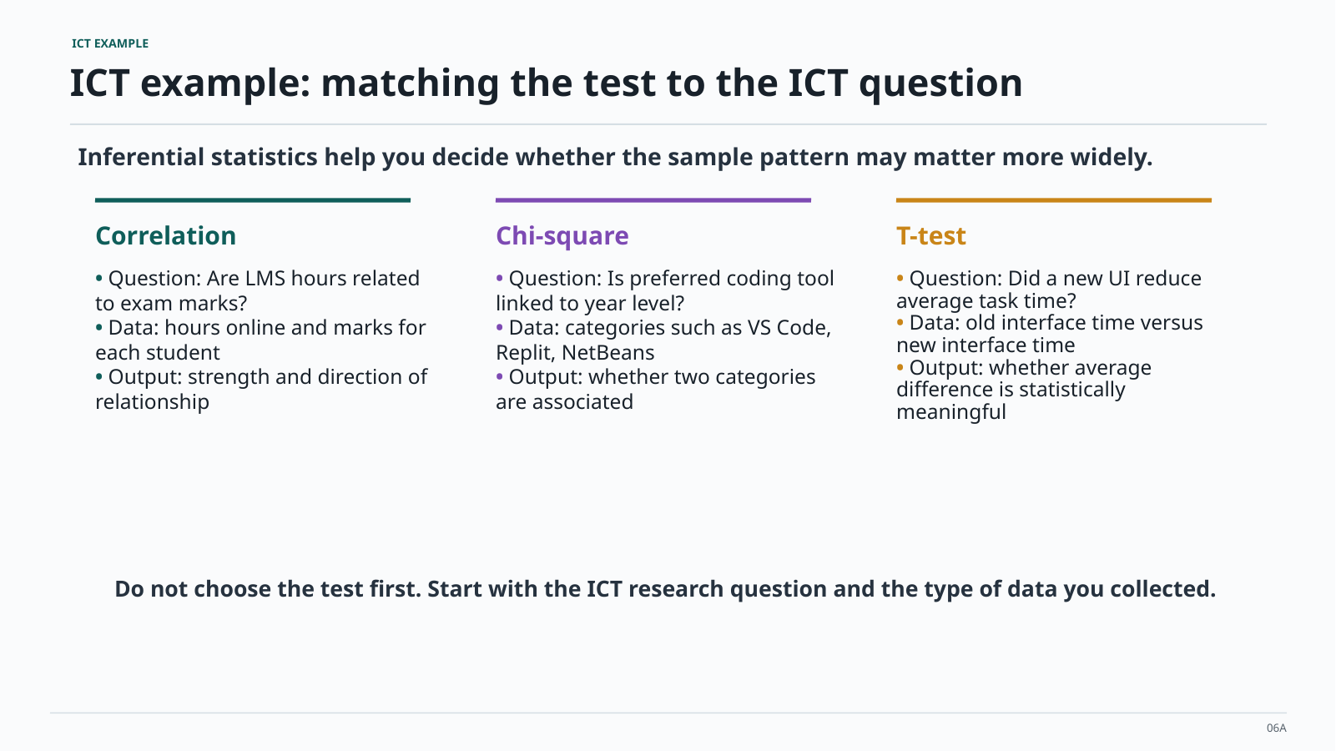
ICT example: matching the test to the ICT question
Inferential statistics help you decide whether the sample pattern may matter more widely.
Do not choose the test first. Start with the ICT research question and the type of data you collected
06A

Slide 19
SLR caution: not every SLR needs inferential testing
In many student SLRs, analysis is descriptive or thematic. Inferential statistics are only suitable when the extracted quantitative data can fairly be compared.
Usually appropriate
Sometimes appropriate
Be careful
Frequency tables
Percentages
Publication trends
Method categories
Theme counts
Evidence mapping
Comparing extracted numeric outcomes across studies, only if the studies measure similar things in compatible ways.
A t-test, correlation or chi-square test should not be forced onto a literature review just because the lecture covered it.
For your SLR projects, the reccommended route is: count clearly, describe honestly, then explain patterns using the literature.
15

Slide 20
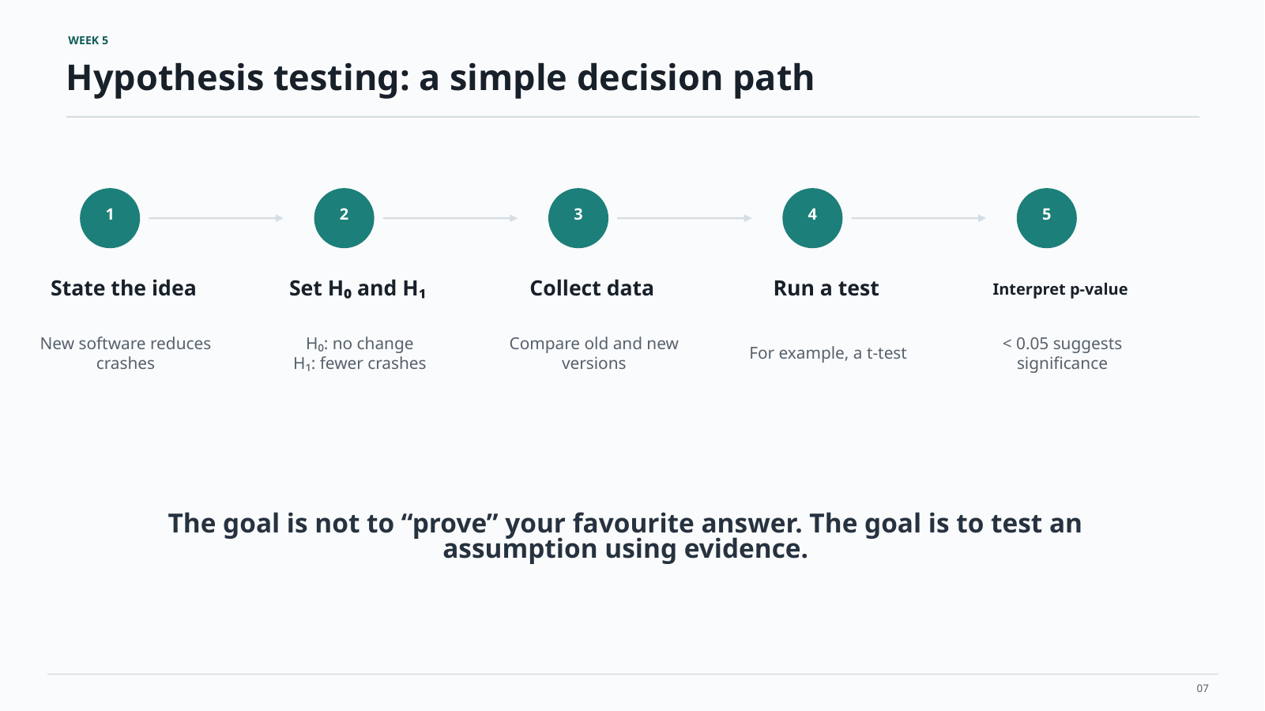
Hypothesis testing: a simple decision path
07

Slide 21
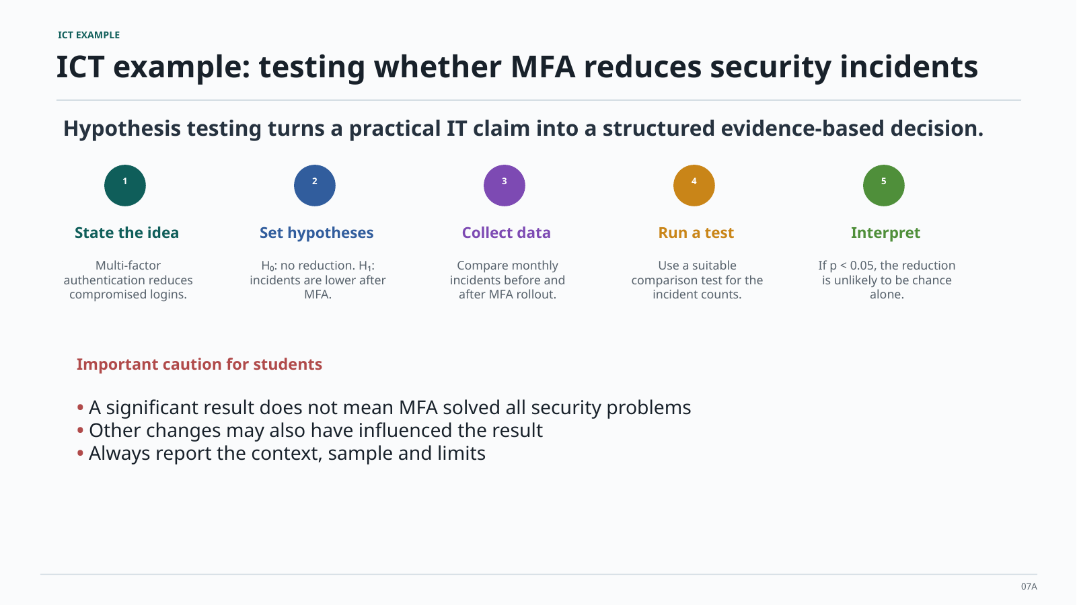
ICT example: testing whether MFA reduces security incidents
Hypothesis testing turns a practical IT claim into a structured evidence-based decision.
A significant result does not mean MFA solved all security problems
Other changes may also have influenced the result
Always report the context, sample and limits
07A

Slide 22
In an SLR, your research question becomes an extraction plan
The analysis starts before reading deeply: decide what information every included paper will contribute.
SLR question
Extracted quantitative data
Extracted qualitative data
How is AI used in software testing?
Year, tool type, method, sample size, reported accuracy
Benefits, risks, developer concerns, implementation barriers
What affects adoption of e-learning apps?
Number of studies by country, population and platform
Reasons for use, reasons for non-use, design recommendations
How do SMEs use cybersecurity tools?
Tool categories, study type, sector, attack type
Barriers, trust issues, cost concerns, training needs
Build the extraction table first. That table is the bridge between PRISMA screening and data analysis.
18

Slide 23
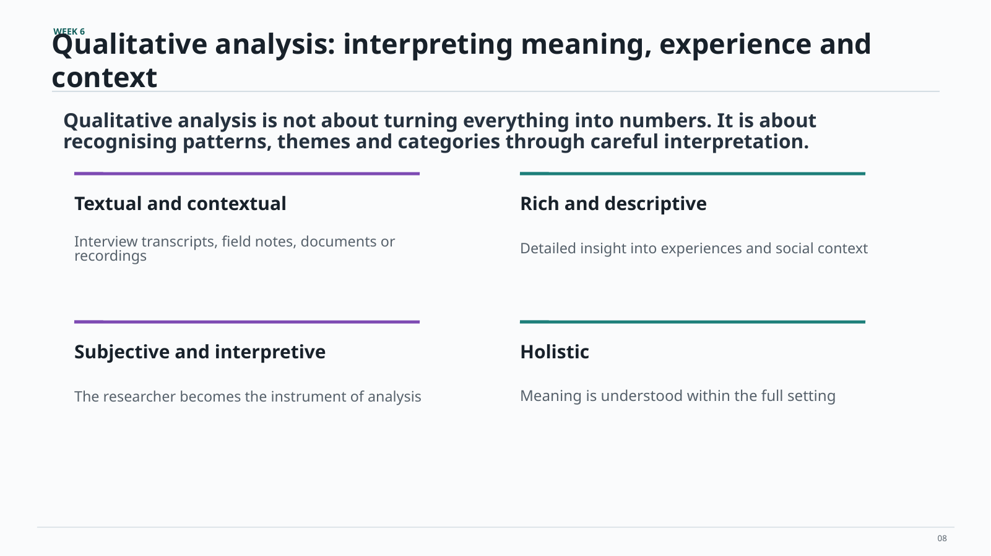
Qualitative analysis: interpreting meaning, experience and context
Qualitative analysis is not about turning everything into numbers. It is about
recognising patterns, themes and categories through careful interpretation.
Rich and descriptive
Interview transcripts, field notes, documents or
Detailed insight into experiences and social context
recordings
Subjective and interpretive
The researcher becomes the instrument of analysis
Meaning is understood within the full setting
08

Slide 24
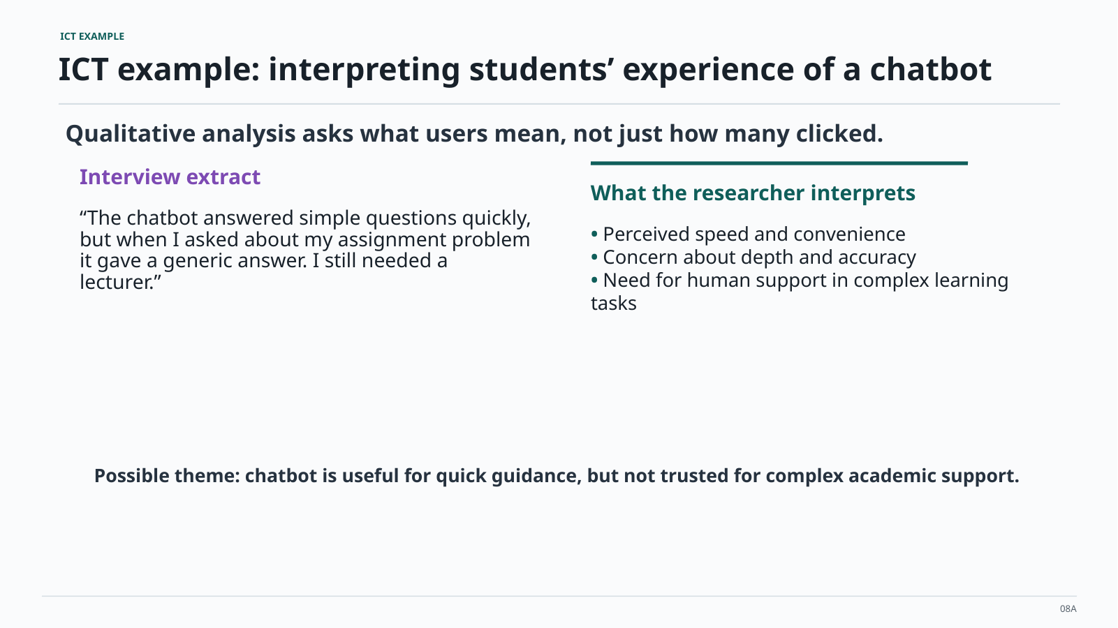
ICT example: interpreting students’ experience of a chatbot
Possible theme: chatbot is useful for quick guidance, but not trusted for complex academic support
08A

Slide 25
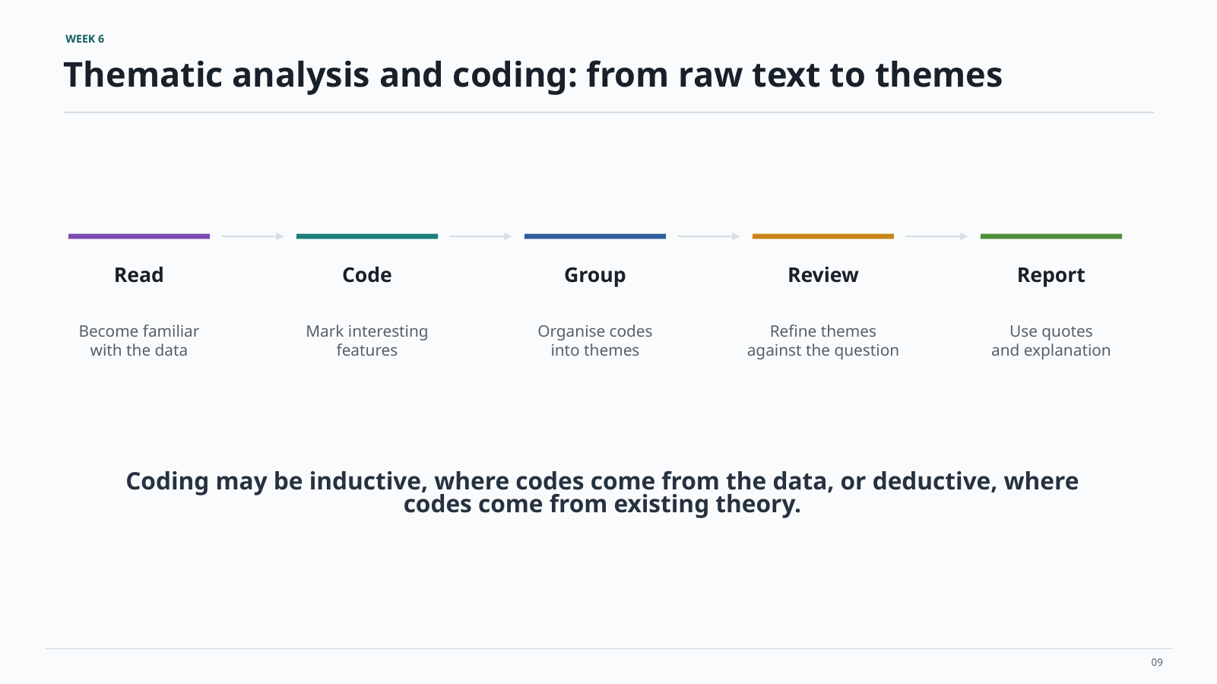
Thematic analysis and coding: from raw text to themes
09

Slide 26
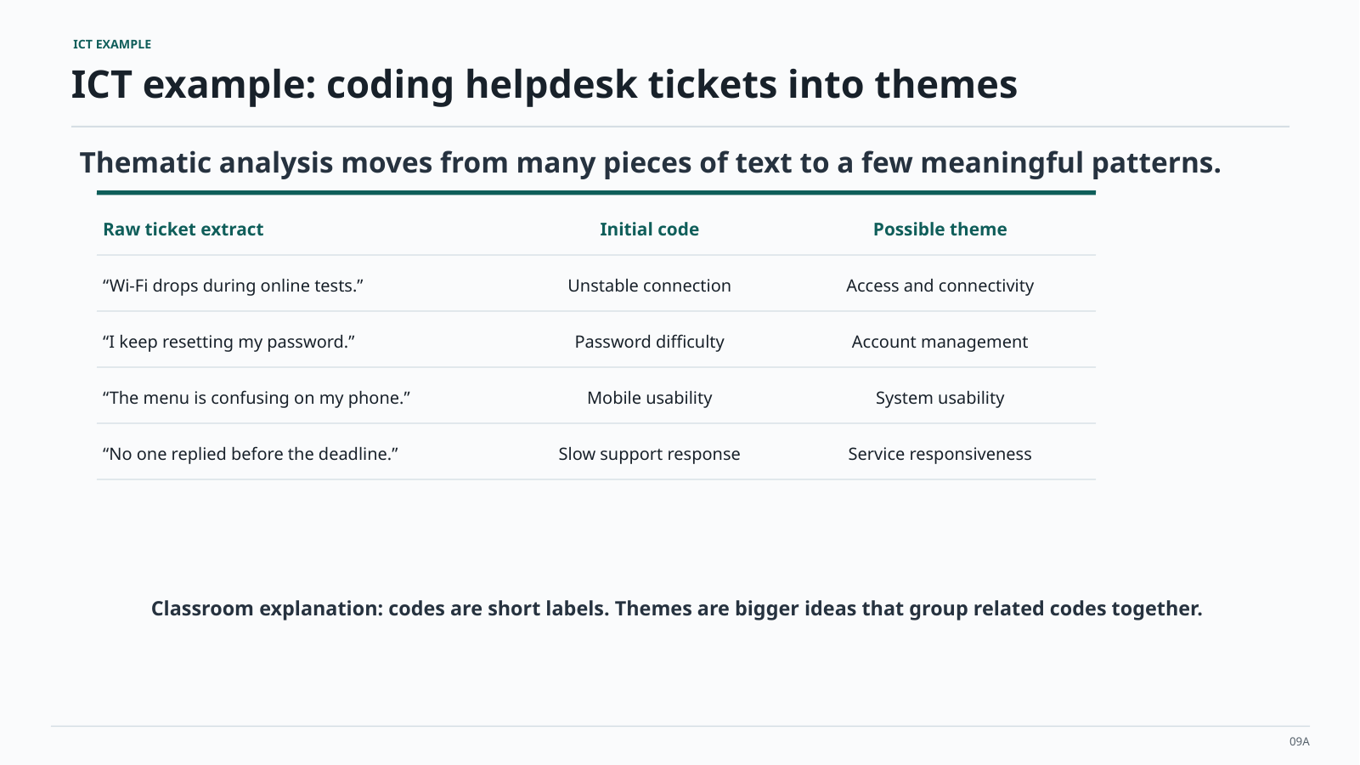
ICT example: coding helpdesk tickets into themes
Thematic analysis moves from many pieces of text to a few meaningful patterns.
“Wi-Fi drops during online tests.”
Unstable connection
Access and connectivity
“I keep resetting my password.”
Password difficulty
Account management
“The menu is confusing on my phone.”
Mobile usability
System usability
“No one replied before the deadline.”
Slow support response
Service responsiveness
Codes are short labels. Themes are bigger ideas that group related codes together.
09A

Slide 27
SLR qualitative example: code findings from papers into themes
You are not coding interview transcripts. You are coding relevant findings, discussion sections, and author explanations from the included papers.
Extract from included study
Initial code
Possible SLR theme
“Students avoided the app because mobile data costs were high.”
Cost of access
Digital access barriers
“Lecturers reported limited training in analytics dashboards.”
Staff capability gap
Readiness and skills
“Participants trusted recommendations only when explanations were visible.”
Need for explainability
Trust in AI systems
“Poor integration with existing LMS tools reduced usage.”
Weak system integration
Implementation constraints
SLR output: themes synthesise what the body of literature says, not what one individual respondent said.
23

Slide 28
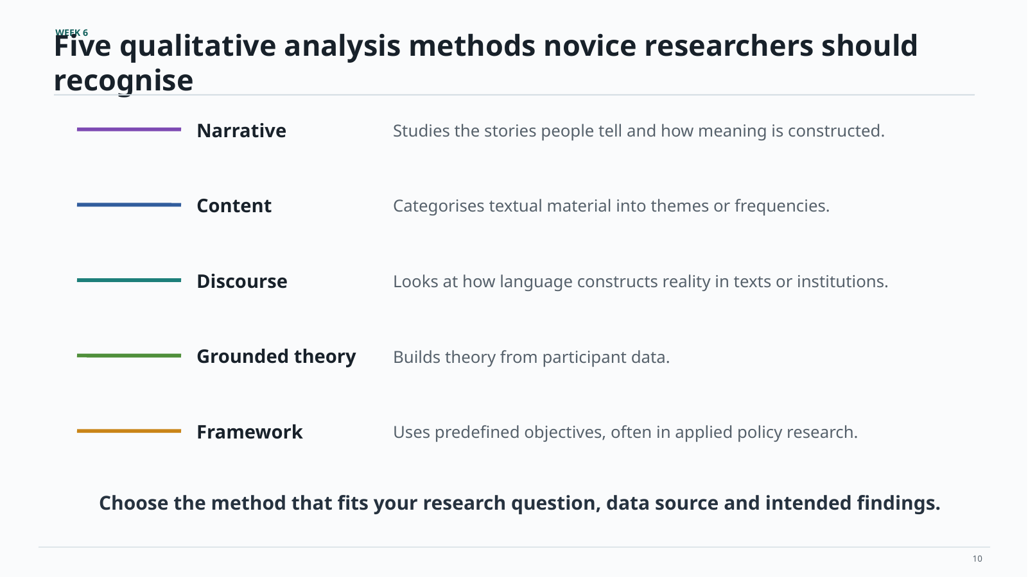
Five qualitative analysis methods novice researchers should recognise
Studies the stories people tell and how meaning is constructed.
Categorises textual material into themes or frequencies.
Looks at how language constructs reality in texts or institutions.
Builds theory from participant data.
Uses predefined objectives, often in applied policy research.
Choose the method that fits your research question, data source and intended findings
10

Slide 29
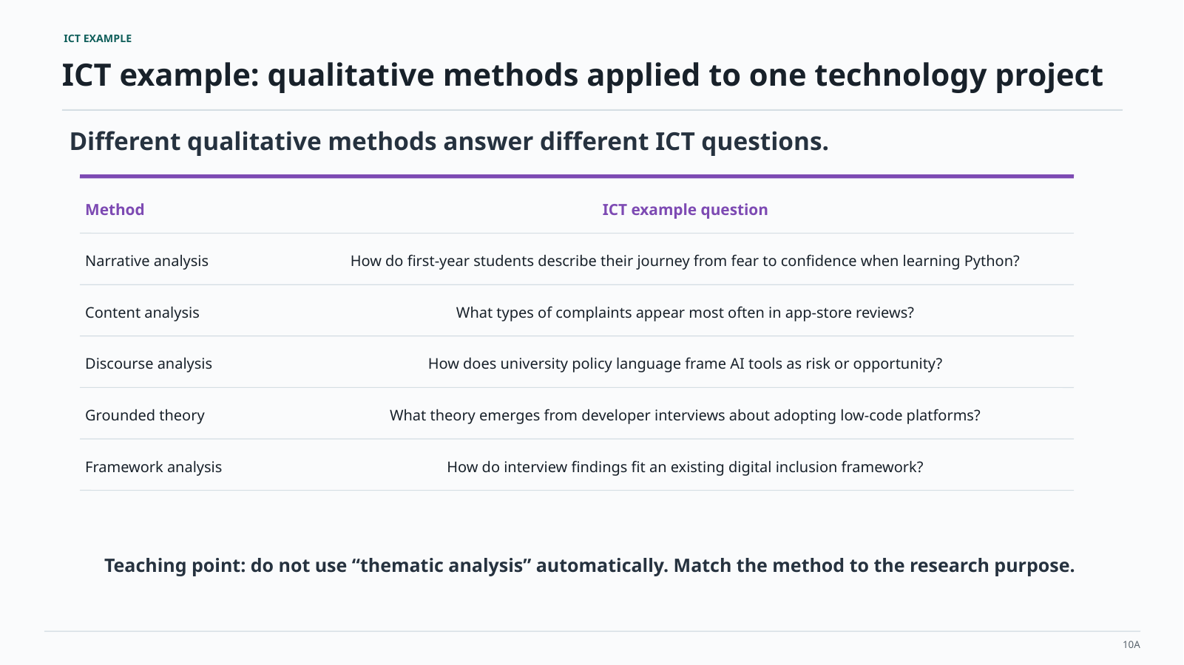
ICT example: qualitative methods applied to one technology project
Different qualitative methods answer different ICT questions.
Narrative analysis
How do first-year students describe their journey from fear to confidence when learning Python?
Content analysis
What types of complaints appear most often in app-store reviews?
Discourse analysis
How does university policy language frame AI tools as risk or opportunity?
What theory emerges from developer interviews about adopting low-code platforms?
Framework analysis
How do interview findings fit an existing digital inclusion framework?
Do not use “thematic analysis” automatically. Match the method to the research purpose.
10A

Slide 30
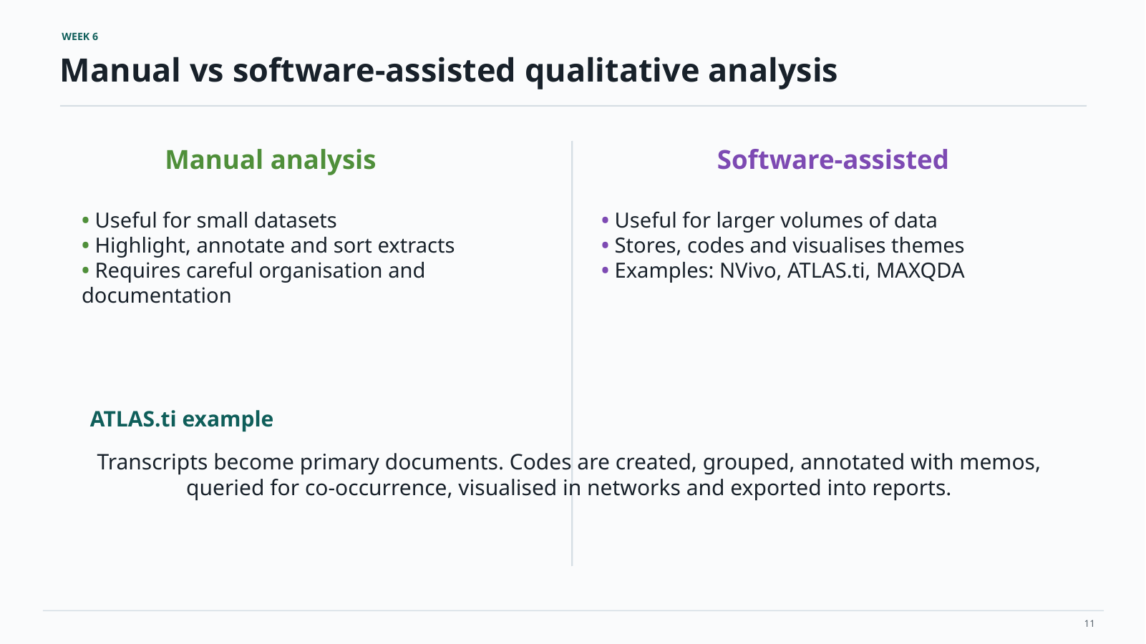
Manual vs software-assisted qualitative analysis
ATLAS.ti example
Transcripts become primary documents. Codes are created, grouped, annotated with memos,
queried for co-occurrence, visualised in networks and exported into reports.
11

Slide 31
SLR analysis tools: spreadsheet first, software if text-heavy
Students often think they need advanced software. For a novice SLR, the priority is a clean audit trail.
Spreadsheet route
Reference manager route
CAQDAS route
Best for most SLRs
Use columns for study ID, author, year, method, technology, country, sample, key finding, code and theme.
Useful for screening and organising
Use it to manage sources, duplicates and included/excluded papers. Analysis still needs an extraction table.
Useful when findings are text-heavy
Use software such as ATLAS.ti or NVivo if many paragraphs must be coded and retrieved.
Software does not create the analysis. Your extraction decisions create the analysis.
27

Slide 32
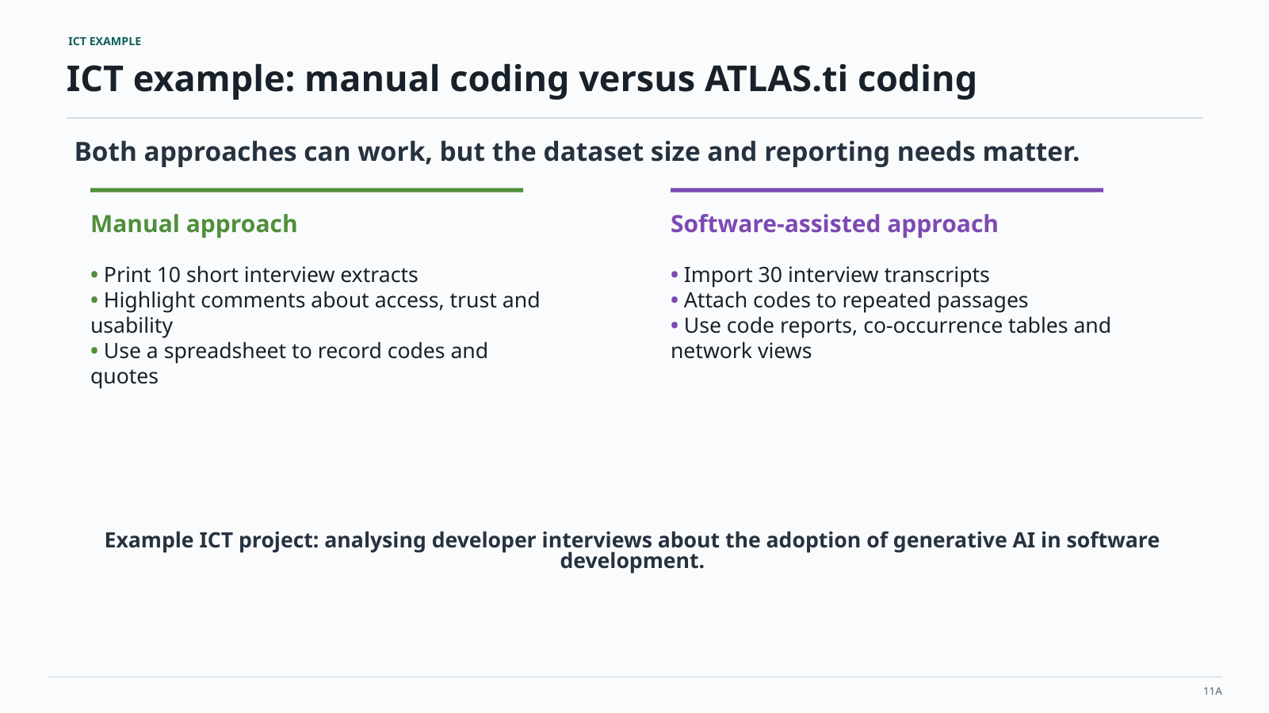
ICT example: manual coding versus ATLAS.ti coding
Both approaches can work, but the dataset size and reporting needs matter.
Manual approach
Software-assisted approach
11A

Slide 33
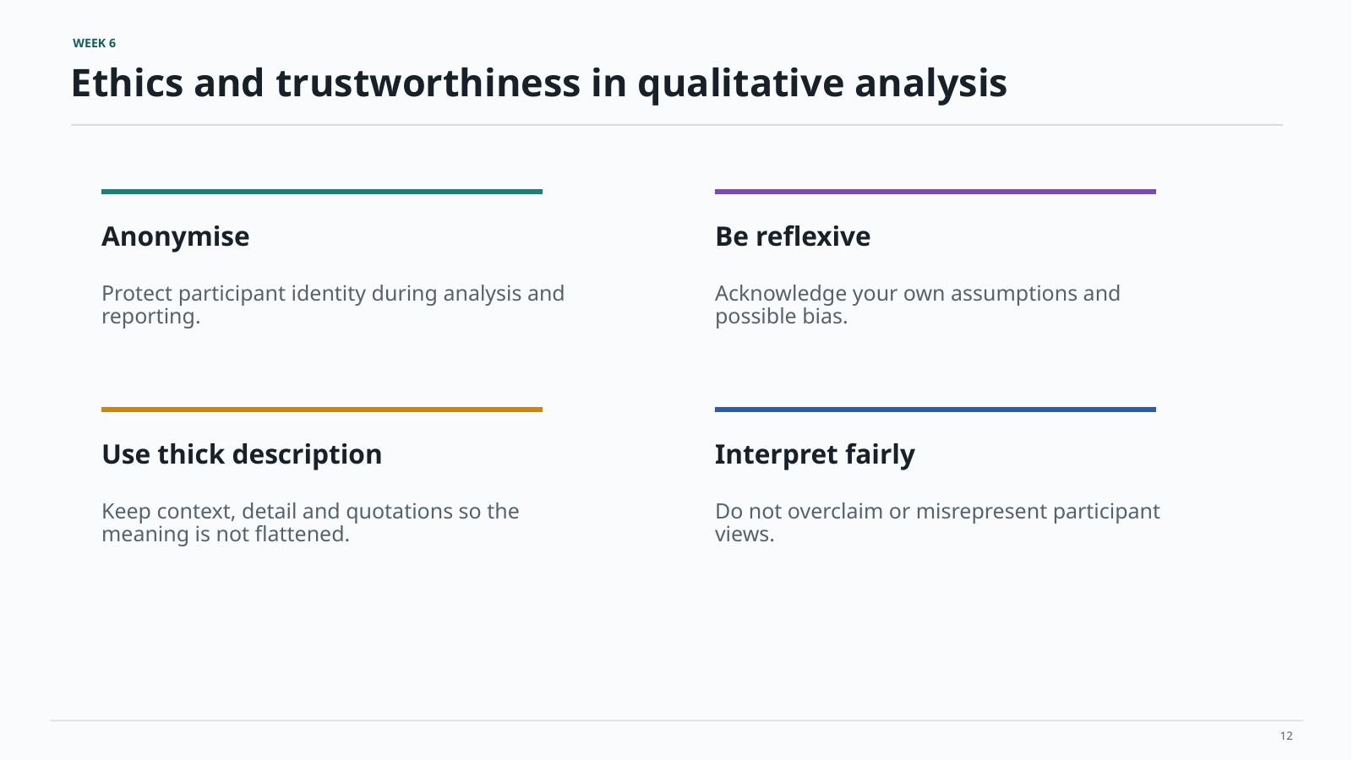
Ethics and trustworthiness in qualitative analysis
Anonymise
Use thick description
Interpret fairly
12

Slide 34
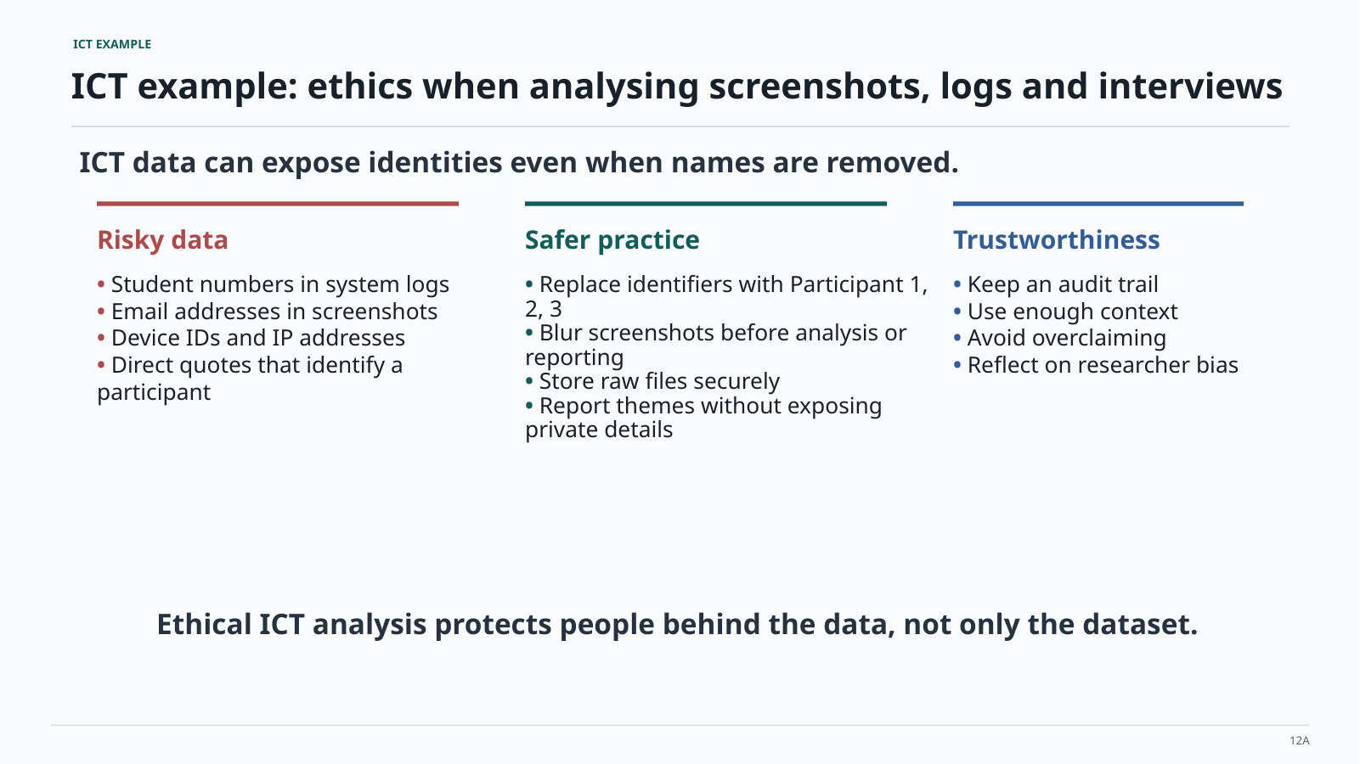
ICT example: ethics when analysing screenshots, logs and interviews
ICT data can expose identities even when names are removed.
Ethical ICT analysis protects people behind the data, not only the dataset.
12A

Slide 35
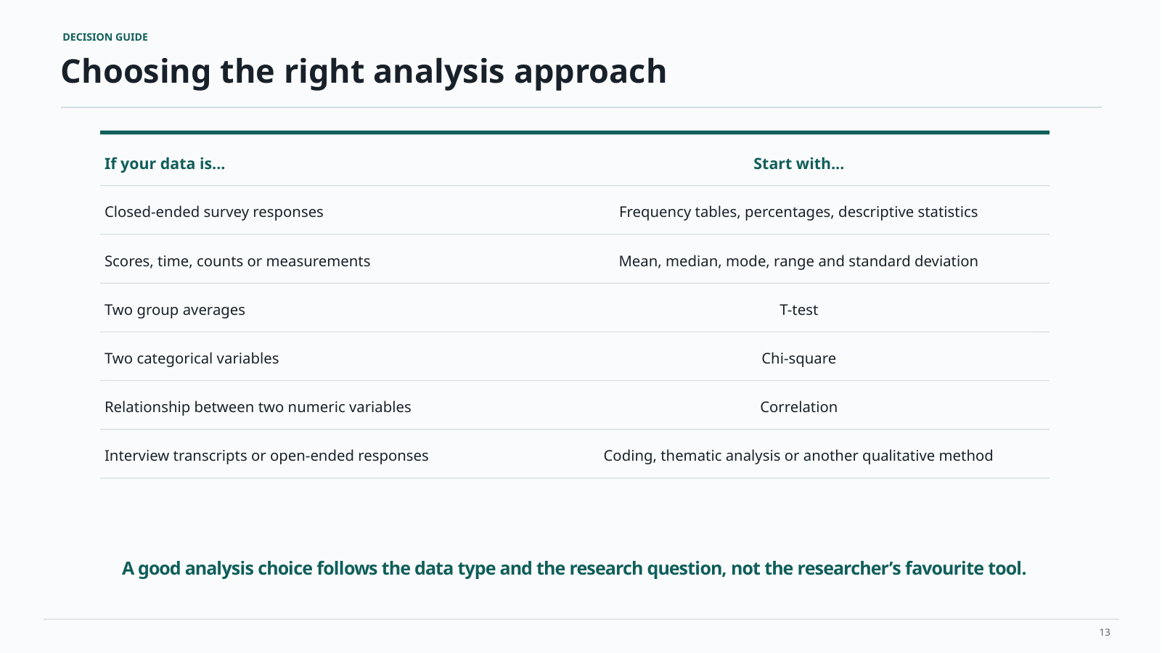
Choosing the right analysis approach
A good analysis choice follows the data type and the research question, not the researcher's favourite tool
13

Slide 36
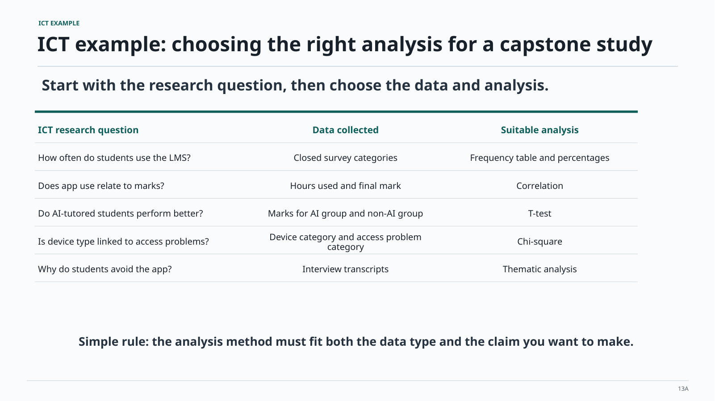
ICT example: choosing the right analysis for a capstone study
Start with the research question, then choose the data and analysis.
Simple rule: the analysis method must fit both the data type and the claim you want to make
13A

Slide 37
Choose the SLR analysis route that fits your data
This is the decision students must make after screening the papers and before writing the findings.
What your included studies give you
Best analysis route
Example SLR output
Mostly categories and counts
Quantitative descriptive synthesis
18/40 papers used machine learning classifiers
Mostly author explanations and findings
Qualitative thematic synthesis
Four themes explain adoption barriers
Both counts and explanations
Mixed synthesis
Counts show the pattern; themes explain why it matters
Comparable effect sizes or outcomes
Advanced quantitative synthesis
Only consider this with strong statistical guidance
Final reminder: in an SLR, quantitative data often comes from counting papers, while qualitative data comes from interpreting what the papers say.
33

Slide 38
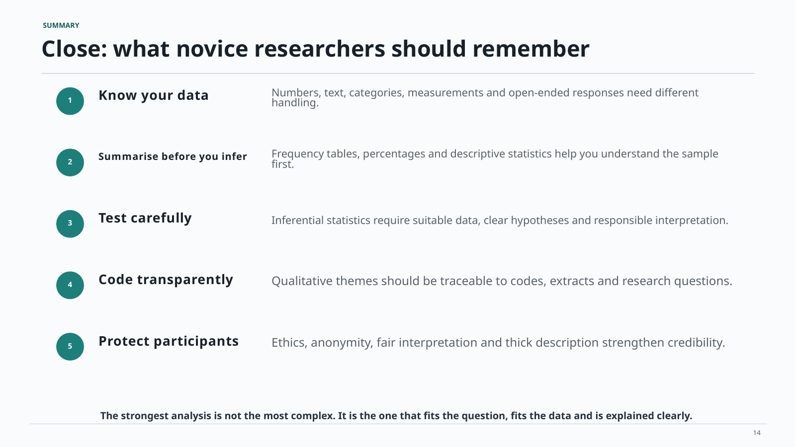
Close: what novice researchers should remember
The strongest analysis is not the most complex. It is the one that fits the question, fits the data and is explained clearly.
14

